Slide 1
Chapter-6
Introduction to 8085 Instructions
Example 6.2:
Write instructions to read eight ON/OF switches connected to the address 00H, and turn on the devices connected to the output port with the address 01H, as shown in Figure 6.1. (I/O port addresses are given in hexadecimal.)
Solution:
The input has eight switches that are connected to the data bus through the tri-state buffer. Any one of the switches can be connected to +5V (logic 1) or to ground (logic 0), and each switch controls the corresponding device at the output port.
Instructions
IN 00H
OUT 01H
HLT

Slide 2
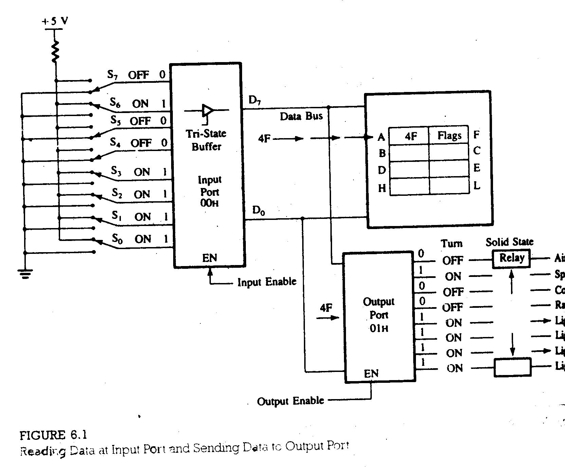

Slide 3
Example 6.8:
In Figure 6.8, keep the radio on (D₄) continuously without affecting the functions of other appliances, even if someone turns off the switch S₄.
Solution
The bit D₄ should be set by Oring the input port with data byte 10H as follows:
In Figure 6.8, assume it is winter, and turn off the air conditioner without affecting the other appliances,
IN 00H : (A) =
D₇ D₆ D₅ D₄ D₃ D₂ D₁ D₀
ORI 10H : =
0 0 0 1 0 0 0 0
(A) = D₇ D₆ D₅ 1 D₃ D₂ D₁ D₀
IN 00H : (A) =
D₇ D₆ D₅ D₄ D₃ D₂ D₁ D₀
ANI 7FH : =
0 1 1 1 1 1 1 1
(A) = 0 D₆ D₅ D₄ D₃ D₂ D₁ D₀

Slide 4
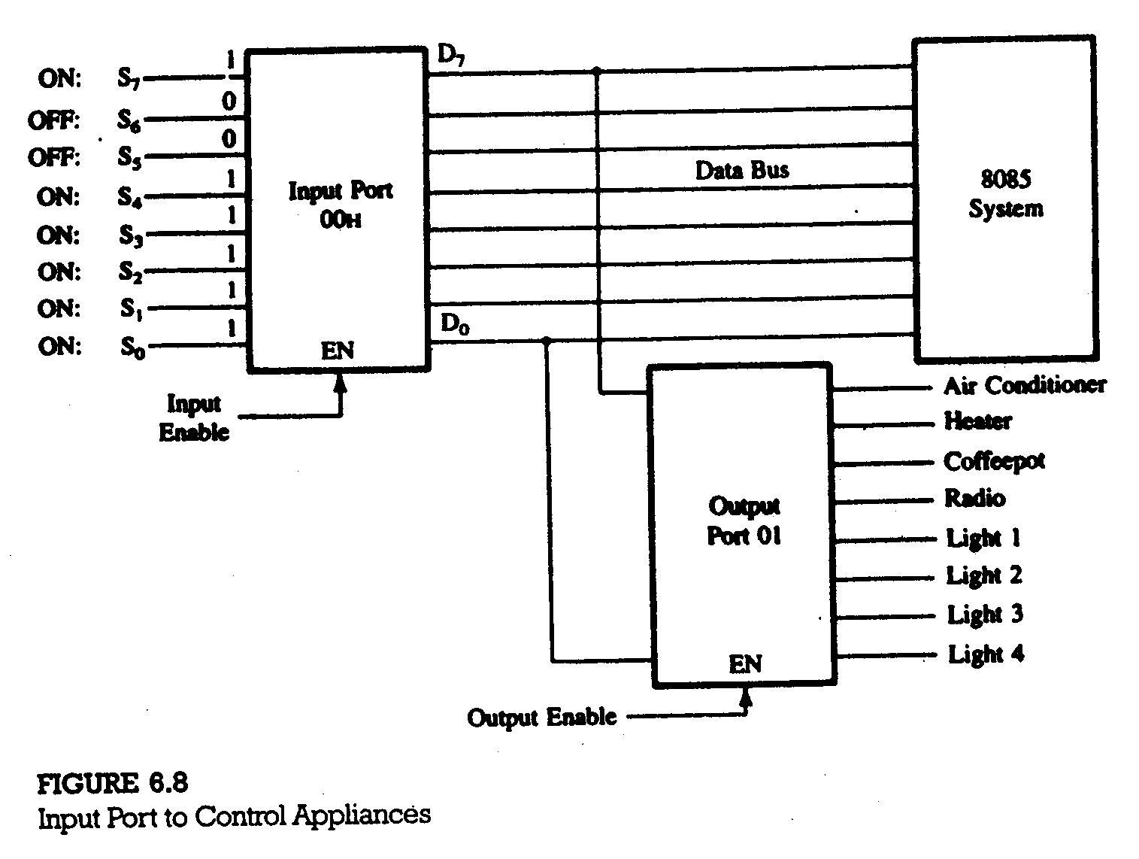

Slide 5
6.35 Illustrative Program: ORing Data from Two Input Ports
PROBLEM STATEMENT
An additional input port with eight switches and the address 01H (Figure 6.9) is connected to the microcomputer shown in Figure 6.8 to control the same appliances and lights from the bedroom as well as from the kitchen. Write instructions turn on the devices from any of the input ports.
PROBLEM ANALYSIS
To turn on the appliances from any of the input ports, the microprocessor needs to read the switches at both ports and logically OR the switch positions.
PROGRM
IN 00H
MOV B,A
IN 01H
ORA B
OUT 01H
HLT

Slide 6
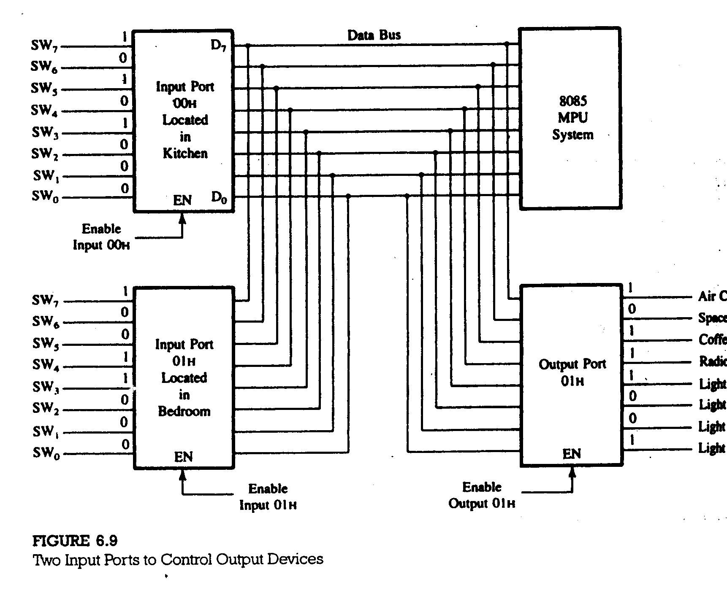

Slide 7
6.52 Illustrative Program: Microprocessor-Controlled Manufacturing Process
PROBLEM STATEMENT
A microcomputer is designed to monitor various processes (conveyer belts) on the floor of a manufacturing plant, presented schematically in Figure 6.12.
Write a program to
Turn on the five conveyer belts according to the ON/OFF positions of switches S₄ – S₀ at port F1H.
Turn off the conveyer belts and turn on the emergency alarm only when both switches – S₇ from port F1H an S₇’ from port F2H – are triggered.
Monitor the switches continuously.

Slide 8
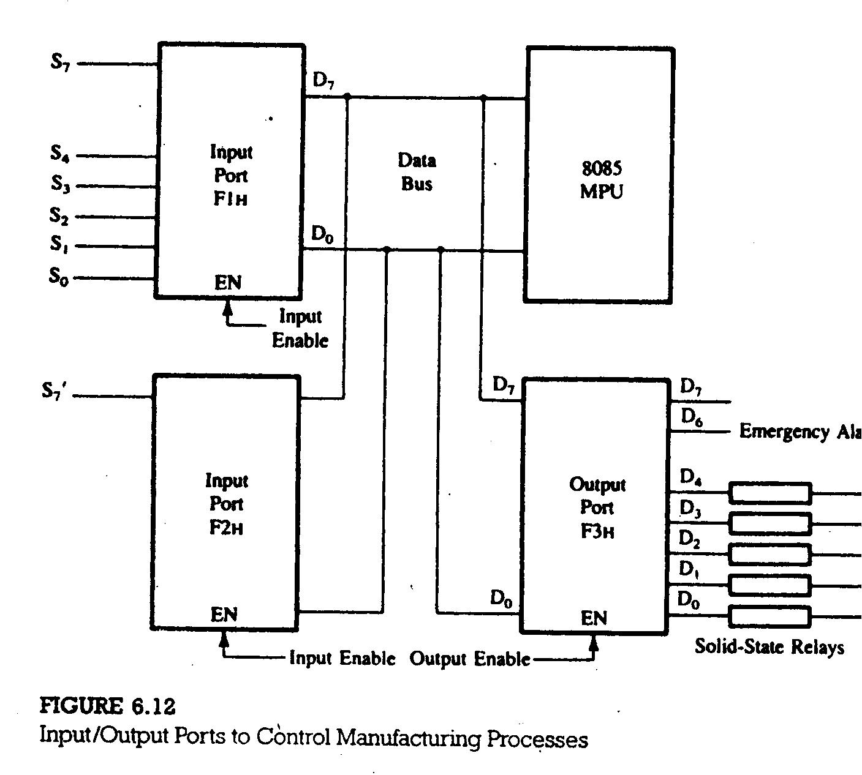

Slide 9
PROBLEM ANALYSIS
To perform the tasks specified in the problem, the microprocessor needs to
read the switch positions.
check whether switches S₇ and S₇’ from the ports F1H and F2H are on.
turn on the emergency signal if both switches are on, and turn off all the conveyer belts.
turn on the conveyer belts according to the switch positions S₀ through S₇ at input port F1H if both switches S₇ and S₇’ are not on simultaneously.
continue checking the switch positions.
FLOWCHART AND PROGRAM
The five steps listed above can be translated into flowchart and an assembly language program as shown in Figure 6.13.

Slide 10
